Slide 1
Choosing a Voltage Regulator (LDO) for Battery Operated Products

Slide 2
Overview
Simplified block diagram of Linear Regulator
Types of Pass elements
Discharge curve of Li-ion battery
Let’s define a problem statement
Selected LDO’s
LTspice simulation of Dropout voltage
LTspice simulation of Quiescent current

Slide 3
Overview
So the voltage regulators are used to provide a stable power supply voltage independent of load impedance or input voltage variations.
Low-dropout regulators have the ability to maintain regulation with small differences between supply voltage and load voltage.
Typical sensitive load circuitry such as radio frequency amplifiers, clock and timing ICs, SERDES, precision analog and image sensors choose LDO for low noise performance.

Slide 4
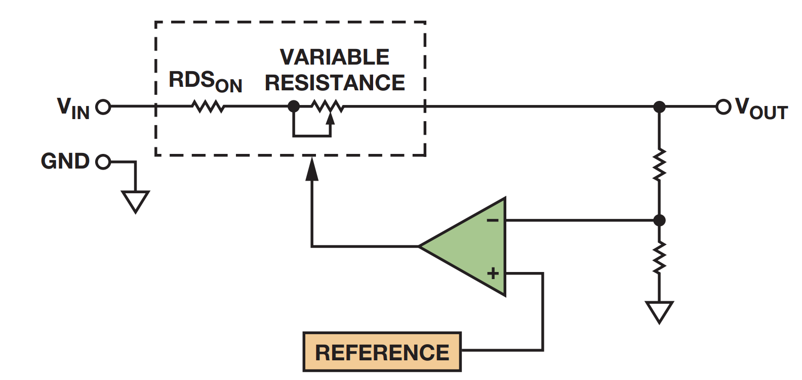
Simplified block diagram of Linear Regulator

Slide 5
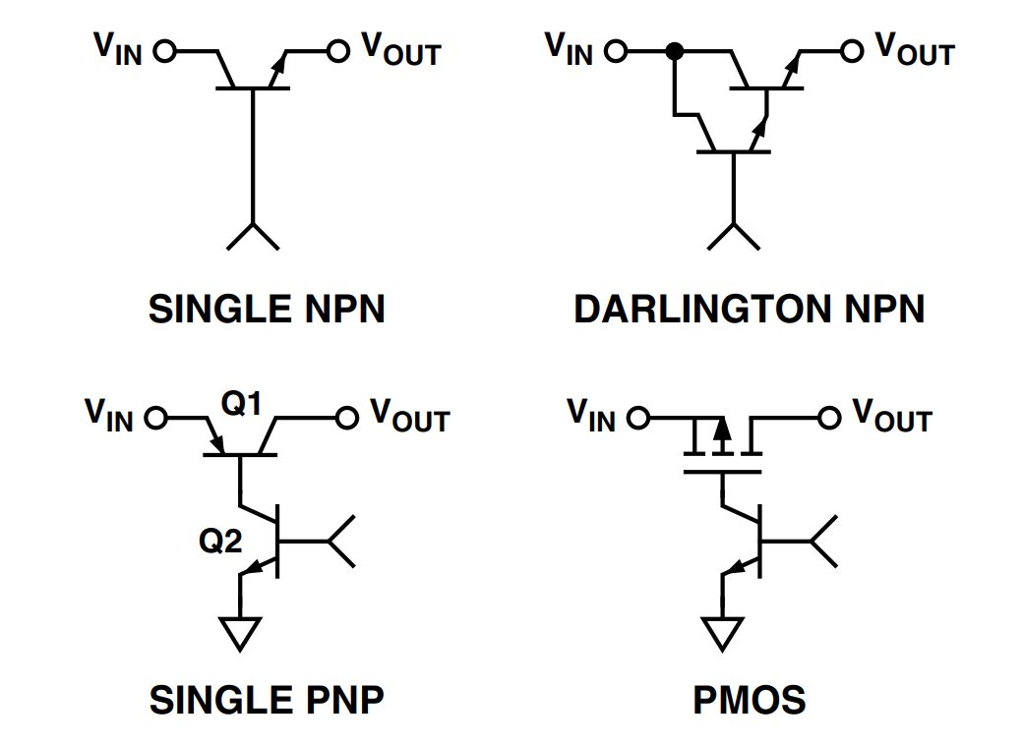
Types of Pass elements
NPN and Darlington transistors are mostly used in standard linear regulators. Due to way NPN and Darlington transistors work, these pass elements cannot provide provide dropout voltages below 1 V.
PMOS and PNP transistors are mostly used in LDO regulators, these pass devices minimize the voltage loss and the power dissipation, thus allowing low dropout, high-efficiency voltage regulators.
PMOS pass devices can provide the lowest possible dropout voltage drop. They also allow the quiescent current flow to be minimized.

Slide 6
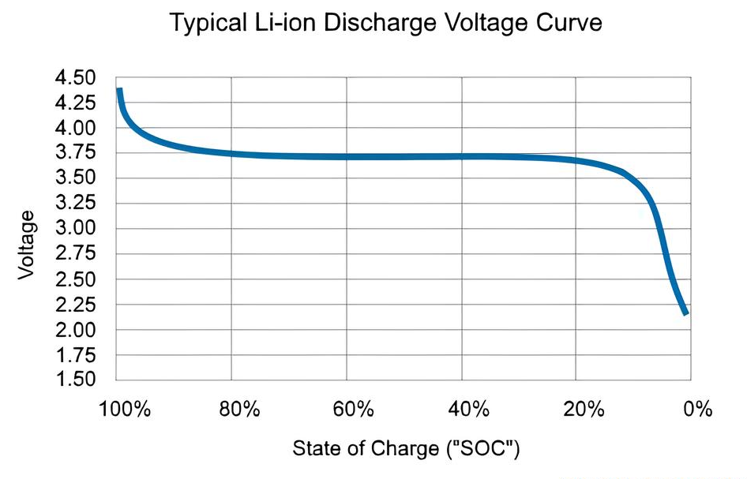
Discharge curve of Li-ion battery

Slide 7
Let's define a problem statement
Device has to operate on Li-ion battery for as long as possible.
Device consists of a microcontroller and sensor circuits.
The microcontroller can operate from 2.5V to 3.3V.
The sensor circuits can operate from 3V to 3.3V.
Li-ion battery protection circuit cuts off the battery at 3V.
The device has a peak current draw of 20mA.
The device must use a LDO for voltage regulation.

Slide 8
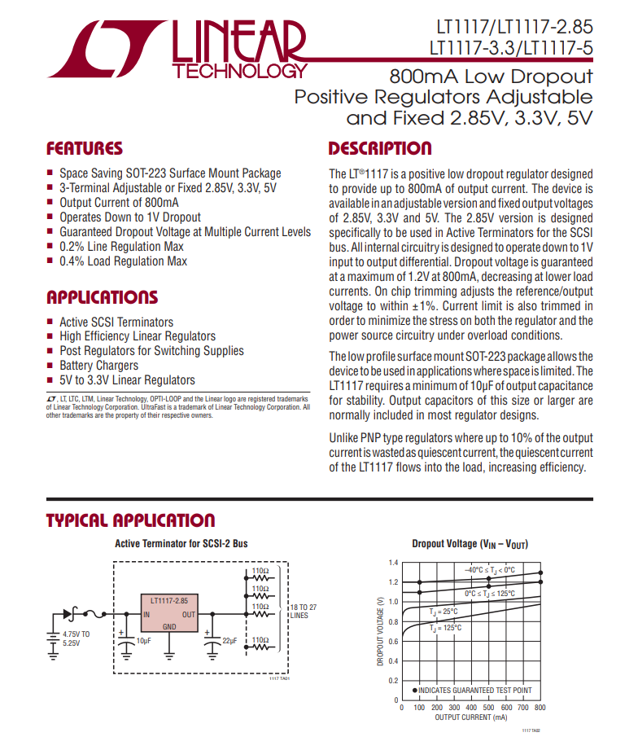
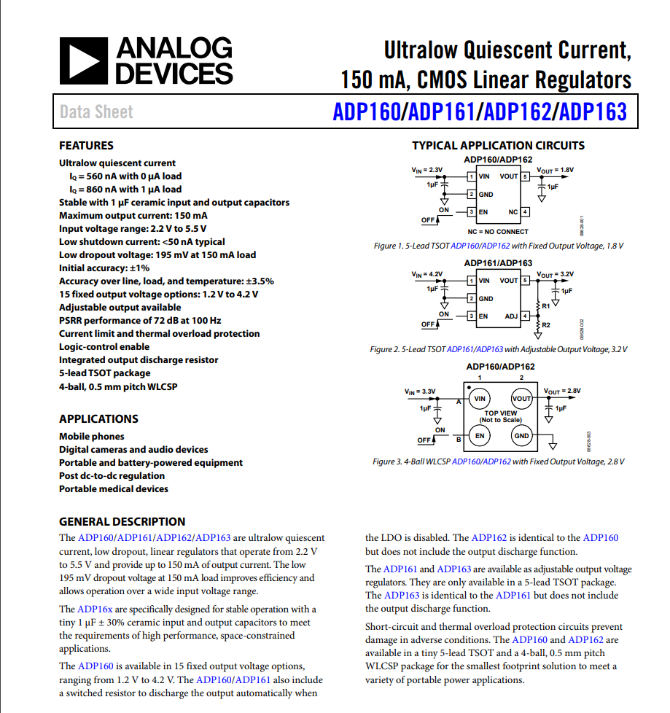

Slide 9

LTspice simulation of Dropout voltage
Dropout voltage determines the range of operation of a device for a battery.

Slide 10
LTspice simulation of Quiescent Current
Quiescent current determines the battery life of device.

Slide 11
Thank you!
For help or to learn more about Choosing correct LDO for battery operations, you can visit the DevHeads GitHub repo where the contents of this demo will be stored or find me in the DevHeads Discord server at @shreeshan97 where I’m available to answer questions based on electronics and embedded issues.

